Slide 1



OS Support for Programming Concurrent & Networked Software: Part 1
Douglas C. Schmidt
d.schmidt@vanderbilt.edu
www.dre.vanderbilt.edu/~schmidt
Professor of Computer Science
Institute for Software Integrated Systems Vanderbilt University Nashville, Tennessee, USA

Slide 2
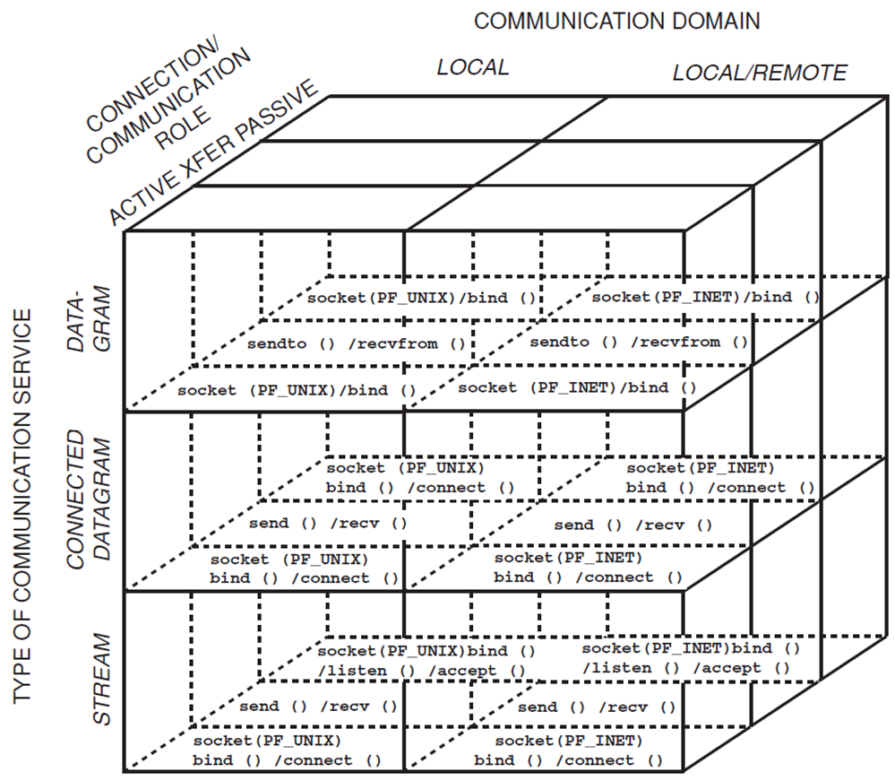
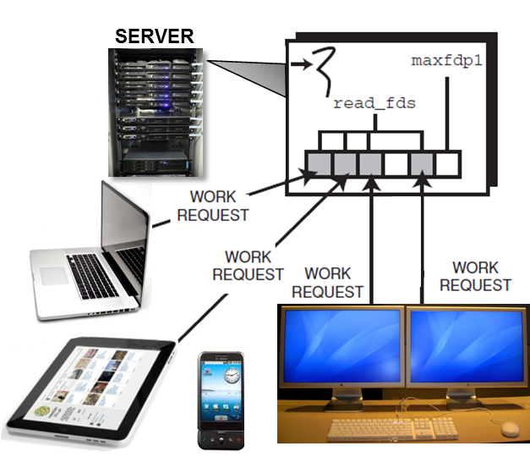
Topics Covered in this Part of the Module
Present an overview of operating system mechanisms available to implement networked apps that
Communicate via the Sockets API &
Use the select() function
There are no source code examples in this part (we’ll examine source later)

Slide 3

Overview of the Sockets API
Originally developed in BSD Unix as a C language interface to the TCP/IP protocol suite
The Sockets network programming API is available on most operating systems
Notes:
http://www.flickr.com/photos/40567541@N08/8203770880/

Slide 4
Overview of the Sockets API
send()
recv()
bind()
read()
write()
readv()
listen()
writev()
socket()
accept()
sendto()
connect()
recvmsg()
sendmsg()
recvfrom()
setsockopt()
getsockopt()
getpeername()
getsockname()
gethostbyname()
getservbyname()
...
Originally developed in BSD Unix as a C language interface to the TCP/IP protocol suite
The Socket API has approximately two dozen functions
See en.wikipedia.org/wiki/Berkeley_sockets for more info on the Sockets API

Slide 5
Overview of the Sockets API
socket handles
Originally developed in BSD Unix as a C language interface to the TCP/IP protocol suite
The Socket API has approximately two dozen functions
A socket is a handle created by the OS that is associated with an end point of a communication channel
The Sockets API
PF_INET Sockets
SOCK_ STREAM
SOCK_ DGRAM
SOCK_ RAW
TCP
UDP
IP
Network Interface

Slide 6


Overview of the Sockets API
Originally developed in BSD Unix as a C language interface to the TCP/IP protocol suite
The Socket API has approximately two dozen functions
A socket is a handle created by the OS that is associated with an end point of a communication channel
A socket can be bound to a local or remote address
e.g., a TCP/UDP port number & IP address
Remote address
Local address
Socket
Socket

Slide 7

Overview of the Sockets API
Originally developed in BSD Unix as a C language interface to the TCP/IP protocol suite
The Socket API has approximately two dozen functions
A socket is a handle created by the OS that is associated with an end point of a communication channel
A socket can be bound to a local or remote address
Sockets are often used to create a bi-directional “reliable” communication link between software processes
e.g., via TCP/IP
Socket
Socket
TCP/IP
Notes:
http://www.flickr.com/photos/52736525@N07/8044851757, http://www.flickr.com/photos/39747297@N05/5229733647/

Slide 8
Features of the Socket API
Local context management
Provides functions to manage local context information
This information is typically stored within the OS kernel or in system libraries
Function | Description
socket() | A factory function that allocates & initializes a socket handle & returns it to the caller
close() | Deallocates a socket handle, making it available for reuse
bind() | Associates a socket handle with a local or remote address
getsockname() | Returns the local address to which a socket is bound
getpeername() | Returns the remote address to which a socket is bound

Slide 9
Features of the Socket API
Connection establishment & termination
Provides functions to set up & tear down connections actively or passively
Function | Description
listen() | Indicates willingness to listen passively for incoming client connection requests
connect() | Establishes a connection actively on an initialized socket handle
accept() | A factory function that creates a new communication endpoint to service client requests
shutdown() | Selectively terminates the read-side and/or write-side stream of a bidirectional connection

Slide 10
Features of the Socket API
Data transfer mechanisms
Provides functions to send & receive data via socket handles
Function | Description
send() recv() | Transmit & receive buffers of data via a particular I/O handle
sendto() recvfrom() | Exchanges connectionless datagrams, where each sendto() call provides the networking address of the recepient
read() write() | Receive & transmit buffers of data via a particular handle
readv() writev() | Supports scatter-read & gather-write semantics, respectively, to optimize mode switching & simplify memory management
sendmsg() recvmsg() | General-purpose functions that subsume the behavior of other data transfer functions
Socket functions

Slide 11
Features of the Socket API
Data transfer mechanisms
Provides functions to send & receive data via socket handles
Function | Description
send() recv() | Transmit & receive buffers of data via a particular I/O handle
sendto() recvfrom() | Exchanges connectionless datagrams, where each sendto() call provides the networking address of the recepient
read() write() | Receive & transmit buffers of data via a particular handle
readv() writev() | Supports scatter-read & gather-write semantics, respectively, to optimize mode switching & simplify memory management
sendmsg() recvmsg() | General-purpose functions that subsume the behavior of other data transfer functions
POSIX functions

Slide 12
Features of the Socket API
Options management
Provides functions that allow programmers to alter default socket & protocols behavior
e.g., enable multicasting, broadcasting, modifying/ querying size of transport buffers, enabling/disabling Nagle’s algorithm, etc.
Function | Description
setsockopt() | Modifies options in different protocol stack layers
getsockopt() | Queries options in different protocol stack layers

Slide 13
Features of the Socket API
Network addressing
Provides functions to resolve humanly readable names to low-level network addresses, etc.
Function | Description
gethostbyname() gethostbyaddr() | Handle network address mapping between hostnames & IPv4 addresses
getipnodebyname() getipnodebyaddr() | Handle network address mapping between hostnames & IPv4/IPv6 addresses
getservbyname() | Identifies services by their humanly readable names

Slide 14

Taxonomy of Sockets API Dimensions
Type of communication service
e.g., streams vs. datagrams vs. connected datagrams

Slide 15
Taxonomy of Sockets API Dimensions
Type of communication service
e.g., streams vs. datagrams vs. connected datagrams
Connection & communication role
e.g., clients often initiate connections actively, whereas servers often accept them passively

Slide 16
Taxonomy of Sockets API Dimensions
Type of communication service
e.g., streams vs. datagrams vs. connected datagrams
Connection & communication role
e.g., clients often initiate connections actively, whereas servers often accept them passively
Communication domain
e.g., local host only vs. local or remote host

Slide 17
Taxonomy of Sockets API Dimensions
Type of communication service
e.g., streams vs. datagrams vs. connected datagrams
Connection & communication role
e.g., clients often initiate connections actively, whereas servers often accept them passively
Communication domain
e.g., local host only vs. local or remote host
Note that the Sockets API itself does not clearly demarcate these dimensions

Slide 18
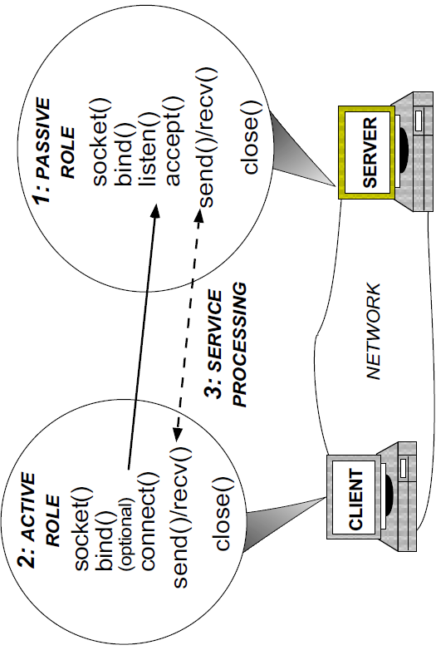

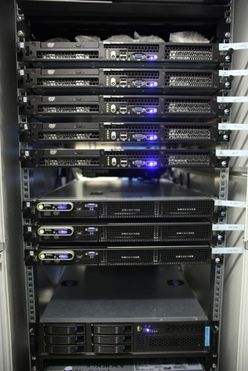
Example Connection & Communication Roles
Typically done by “clients”
3: Communication Role
Typically done by “servers”
Network
Typically done by client & server “business logic”
Notes:
http://www.flickr.com/photos/50894390@N03/4724562099/, http://www.flickr.com/photos/26097071@N05/5356419464/

Slide 19
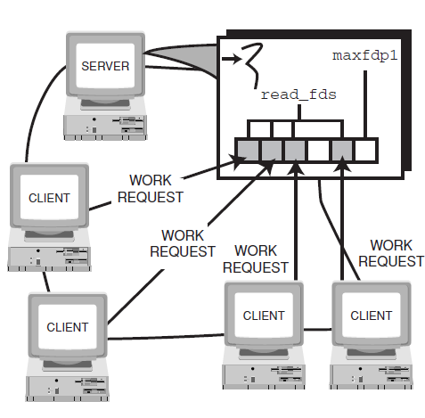
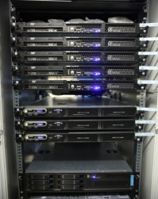




Synchronous Event Demultiplexing
Synchronous event demultiplexing (demuxing) uses multiplexing (muxing) functions to wait for certain events to occur on a set of event sources
e.g., select() & poll() on POSIX, WaitForMultipleObjects() on Windows, etc.
SERVER

Slide 20
Synchronous Event Demultiplexing
Synchronous event demultiplexing (demuxing) uses multiplexing (muxing) functions to wait for certain events to occur on a set of event sources
e.g., select() & poll() on POSIX, WaitForMultipleObjects() on Windows, etc.
The focus of control returns to the caller thread whenever one or more event sources become active
SERVER

Slide 21
Synchronous Event Demuxing with select()
int select (int width, // Maximum handle plus 1
fd_set *read_fds, // Set of "read" handles
fd_set *write_fds, // Set of "write" handles
fd_set *except_fds, // Set of "exception" handles
struct timeval *timeout);// Time to wait for events
The select() API is available on most operating systems

Slide 22
Synchronous Event Demuxing with select()
int select (int width, // Maximum handle plus 1
fd_set *read_fds, // Set of "read" handles
fd_set *write_fds, // Set of "write" handles
fd_set *except_fds, // Set of "exception" handles
struct timeval *timeout);// Time to wait for events
fd_set is a structure (often a bitmask) representing the handles to check for I/O events
e.g., indicating a handle is ready for reading, writing, or exceptions

Slide 23
Synchronous Event Demuxing with select()
int select (int width, // Maximum handle plus 1
fd_set *read_fds, // Set of "read" handles
fd_set *write_fds, // Set of "write" handles
fd_set *except_fds, // Set of "exception" handles
struct timeval *timeout);// Time to wait for events
fd_set is a structure (often a bitmask) representing the handles to check for I/O events
e.g., indicating a handle is ready for reading, writing, or exceptions
fd_sets are passed as “in/out” parameters to select(), which modifies them depending on handle status
e.g.:
If a handle is not active in the fd_set, it is ignored & select will keep it inactive in the fd_set
If a handle is active, select() will determine if there are pending events
If an event is pending, the appropriate fd_set has the handle activated, else its value is made inactive in the returned fd_set
See en.wikipedia.org/wiki/Select_(Unix) for more info on select()

Slide 24
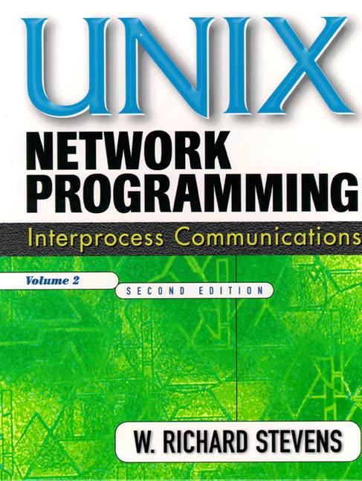
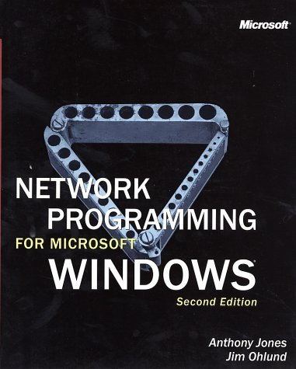
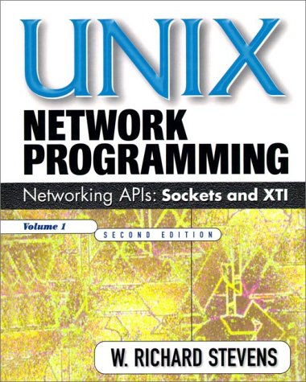
Summary
Many networked apps are written using select() & the Sockets API

Slide 25

Summary
Many networked apps are written using select() & the Sockets API
Despite their ubiquity, there are limitations with select() & Sockets
See static.usenix.org/event/usenix99/ full_papers/banga/banga_html/ final2.html for limitations of select() & comparison with alternatives
Notes:
http://www.flickr.com/photos/75001512@N00/4864207213/

Slide 26
Summary
Many networked apps are written using select() & the Sockets API
Despite their ubiquity, there are limitations with select() & Sockets
See static.usenix.org/event/usenix99/ full_papers/banga/banga_html/ final2.html for limitations of select() & comparison with alternatives
See www.dre.vanderbilt.edu/ ~schmidt/PDF/IPC_SAP-92.pdf for limitations of Sockets & comparison with alternatives
Notes:
http://www.flickr.com/photos/75001512@N00/4864207213/

Slide 27
Summary
Many networked apps are written using select() & the Sockets API
Despite their ubiquity, there are limitations with select() & Sockets
See static.usenix.org/event/usenix99/ full_papers/banga/banga_html/ final2.html for limitations of select() & comparison with alternatives
See www.dre.vanderbilt.edu/ ~schmidt/PDF/IPC_SAP-92.pdf for limitations of Sockets & comparison with alternatives
We’ll later discuss use of patterns & frameworks to overcome these limitations
Reactor
*
Event Handler
handle_events()
register_handler()
remove_handler()
dispatches
handle_event ()
get_handle()
owns
*
Handle
handle set
*
<<uses>>
notifies
Synchronous
Event Demuxer
select ()
Concrete Event Handler A
Concrete Event Handler B

Slide 28
OS Support for Programming Concurrent & Networked Software: Part 2
Douglas C. Schmidt
d.schmidt@vanderbilt.edu
www.dre.vanderbilt.edu/~schmidt
Professor of Computer Science
Institute for Software Integrated Systems Vanderbilt University Nashville, Tennessee, USA

Slide 29
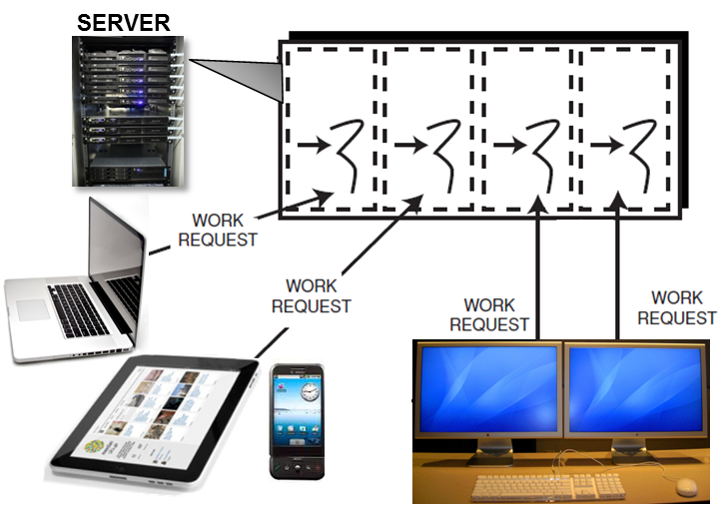
Topics Covered in this Part of the Module
Present an overview of operating system mechanisms available to implement networked apps that
Communicate via the Sockets API &
Use the select() function
Present an overview of OS mechanisms available to implement concurrent apps that
Process multiple requests simultaneously via multiprocessing and/or multithreading
Again, we have no source code examples here since we’ll cover them later

Slide 30
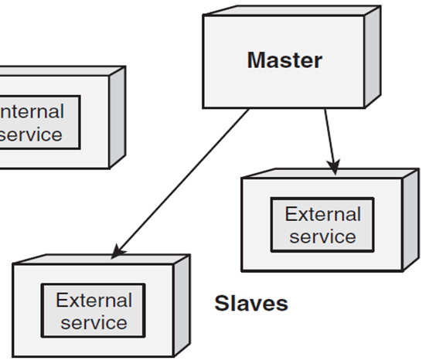
OS Multiprocessing Mechanisms
Multiprocessing mechanisms include the features provided by the OS for creating & managing the execution of multiple processes
Process lifetime operations – create a new process address space for programs to run
Parent
Child
Child

Slide 31
OS Multiprocessing Mechanisms
Multiprocessing mechanisms include the features provided by the OS for creating & managing the execution of multiple processes
Process lifetime operations – create a new process address space for programs to run
e.g., fork() & exec*() on POSIX & CreateProcess() on Windows
Parent
Child
Child

Slide 32
OS Multiprocessing Mechanisms
Multiprocessing mechanisms include the features provided by the OS for creating & managing the execution of multiple processes
Process lifetime operations – create a new process address space for programs to run
e.g., fork() & exec*() on POSIX & CreateProcess() on Windows
The parent process can set command line arguments, environment variables & working directories for the child process
Parent
Child
Child

Slide 33
OS Multiprocessing Mechanisms
Multiprocessing mechanisms include the features provided by the OS for creating & managing the execution of multiple processes
Process lifetime operations – create a new process address space for programs to run
e.g., fork() & exec*() on POSIX & CreateProcess() on Windows
The parent process can set command line arguments, environment variables & working directories for the child process
The child process can terminate voluntarily by reaching the end of its execution or be involuntarily killed via signals (in POSIX) or TerminateProcess() (in Windows)
Parent
Child
Child

Slide 34
OS Multiprocessing Mechanisms
Multiprocessing mechanisms include the features provided by the OS for creating & managing the execution of multiple processes
Process synchronization options – provided by the OS to retain the identity & exit status of a process & report it to the parent
Parent
Child
Child

Slide 35
OS Multiprocessing Mechanisms
Multiprocessing mechanisms include the features provided by the OS for creating & managing the execution of multiple processes
Process synchronization options – provided by the OS to retain the identity & exit status of a process & report it to the parent
e.g.,
POSIX wait() & waitpid()
Windows WaitForSingleObject() & WaitForMultipleObjects()
Parent
Child
Child

Slide 36
OS Multiprocessing Mechanisms
Multiprocessing mechanisms include the features provided by the OS for creating & managing the execution of multiple processes
Process property operations – used to get/set process properties, such as default file access permissions, user identification, resource limits, scheduling priority, & current working directory
Parent
Child
Child

Slide 37
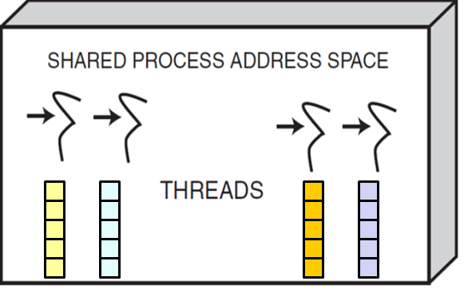
OS Multithreading Mechanisms
Multithreading mechanisms are provided by the OS to handle thread lifetime management, synchronization, properties, & thread-specific storage
Thread lifetime operations – include operations to
Create threads
e.g., pthread_create() (PThreads) & CreateThread() (Windows)

Slide 38
OS Multithreading Mechanisms
Multithreading mechanisms are provided by the OS to handle thread lifetime management, synchronization, properties, & thread-specific storage
Thread lifetime operations – include operations to
Create threads
e.g., pthread_create() (PThreads) & CreateThread() (Windows)
Terminate threads
Voluntarily – by reaching the end point of the thread entry function or calling pthread_exit() (Pthreads) or ExitThread() (Windows)
Involuntary termination of threads is tricky…

Slide 39
OS Multithreading Mechanisms
Multithreading mechanisms are provided by the OS to handle thread lifetime management, synchronization, properties, & thread-specific storage
Thread lifetime operations – include operations to
Create threads
e.g., pthread_create() (PThreads) & CreateThread() (Windows)
Terminate threads
Voluntarily – by reaching the end point of the thread entry function or calling pthread_exit() (Pthreads) or ExitThread() (Windows)
Involuntarily – by being killed via a signal or an asynchronous thread cancelation operations, such as pthread_cancel() (Pthreads) & TerminateThread() (Windows)
Involuntary termination of threads is tricky…

Slide 40
OS Multithreading Mechanisms
Multithreading mechanisms are provided by the OS to handle thread lifetime management, synchronization, properties, & thread-specific storage
Thread synchronization operations – that enable created threads to be
Detached – where the OS reclaims storage used for the thread’s state & exit status after it has exited

Slide 41
OS Multithreading Mechanisms
Multithreading mechanisms are provided by the OS to handle thread lifetime management, synchronization, properties, & thread-specific storage
Thread synchronization operations – that enable created threads to be
Detached – where the OS reclaims storage used for the thread’s state & exit status after it has exited
Joinable – where the OS retains identity & exit status of a terminating thread so other threads can synchronize with it
Operating systems differ considerably wrt their native support for thread sync

Slide 42
OS Multithreading Mechanisms
Multithreading mechanisms are provided by the OS to handle thread lifetime management, synchronization, properties, & thread-specific storage
Thread property operations – includes operations to set & get thread properties, such as priority & scheduling class

Slide 43
OS Multithreading Mechanisms
Multithreading mechanisms are provided by the OS to handle thread lifetime management, synchronization, properties, & thread-specific storage
Thread-specific storage – is similar to global data except that the data is only “global” in the scope of the executing thread

Slide 44
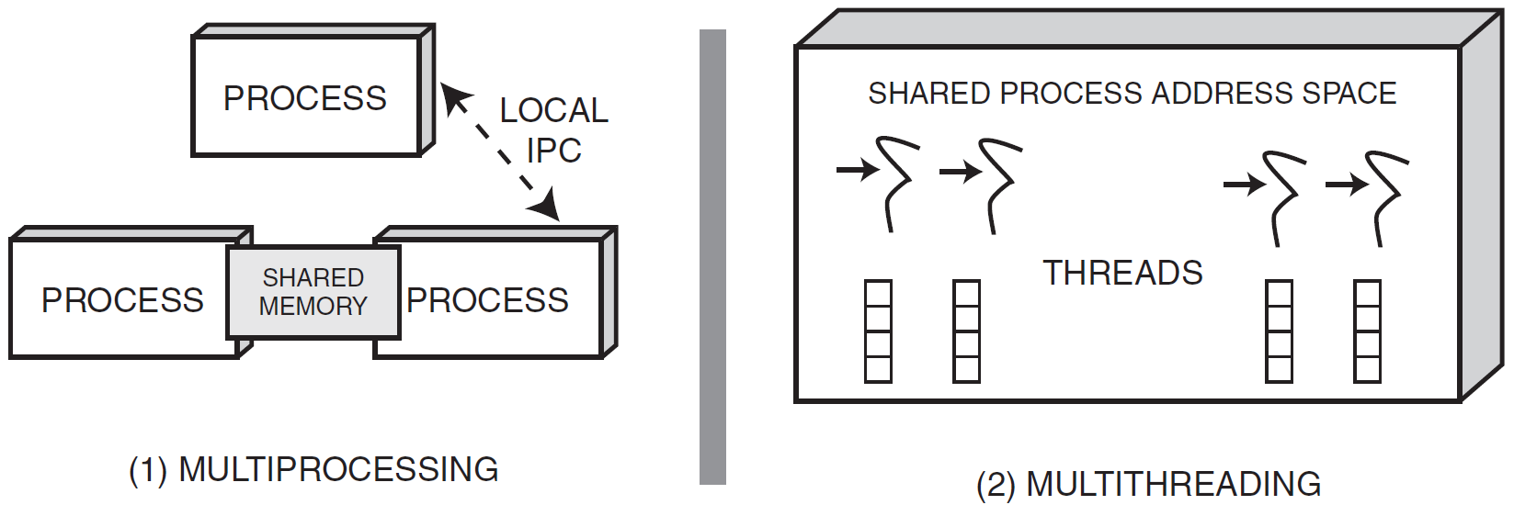
Summary
Operating systems provide concurrency mechanisms that manage multiple processes on an end system & manage multiple threads that run concurrently within a process
Shared Memory

Slide 45
Summary
Operating systems provide concurrency mechanisms that manage multiple processes on an end system & manage multiple threads that run concurrently within a process
Developing concurrent & networked apps using native OS concurrency mechanisms can cause portability, reliability, & sustainment problems
Applications
Solaris
VxWorks
Windows
Linux
LynxOS

Slide 46
Summary
Thread Pool
demultiplexes
Operating systems provide concurrency mechanisms that manage multiple processes on an end system & manage multiple threads that run concurrently within a process
Developing concurrent & networked apps using native OS concurrency mechanisms can cause portability, reliability, & sustainment problems
When used in conjunction with the appropriate patterns & frameworks, concurrency helps to improve performance & simplify program structure
synchronizer
join()
promote_new_leader()
*
Event Handler
Handle
uses
handle_event ()
get_handle()
*
Handle Set
handle_events()
deactivate_handle()
reactivate_handle()
select()
Concrete Event Handler B
handle_event ()
get_handle()
Concrete Event Handler A
handle_event ()
get_handle()

Slide 47
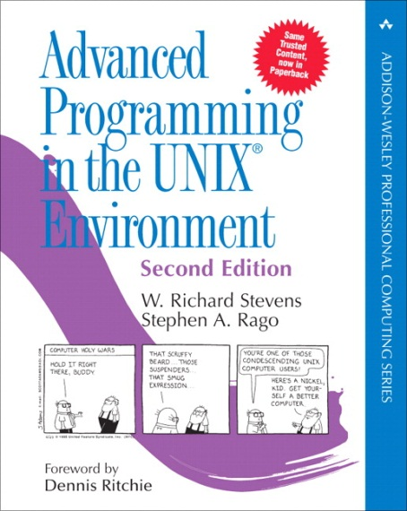
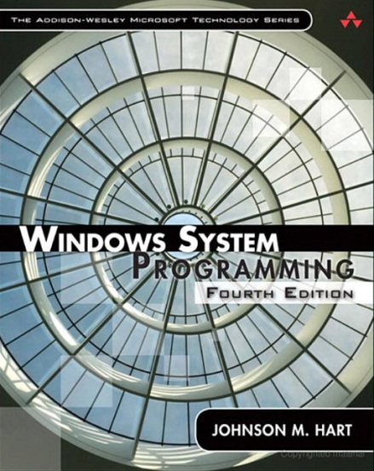
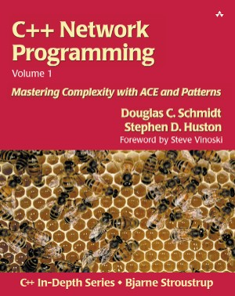
Summary
Operating systems provide concurrency mechanisms that manage multiple processes on an end system & manage multiple threads that run concurrently within a process
Developing concurrent & networked apps using native OS concurrency mechanisms can cause portability, reliability, & sustainment problems
When used in conjunction with the appropriate patterns & frameworks, concurrency helps to improve performance & simplify program structure
The coverage of OS concurrent programming mechanisms is intentionally not comprehensive

Slide 48
OS Support for Programming Concurrent & Networked Software: Part 3
Douglas C. Schmidt
d.schmidt@vanderbilt.edu
www.dre.vanderbilt.edu/~schmidt
Professor of Computer Science
Institute for Software Integrated Systems Vanderbilt University Nashville, Tennessee, USA

Slide 49
Topics Covered in this Part of the Module
Present an overview of operating system mechanisms available to implement networked apps that
Communicate via the Sockets API &
Use the select() synchronous event demultiplexer function
Present an overview of OS mechanisms available to implement concurrent apps that
Process multiple requests simultaneously via multiprocessing and/or multithreading
Synchronize & schedule their interactions
Just one tiny source code example here – we’ll cover many more of them later

Slide 50
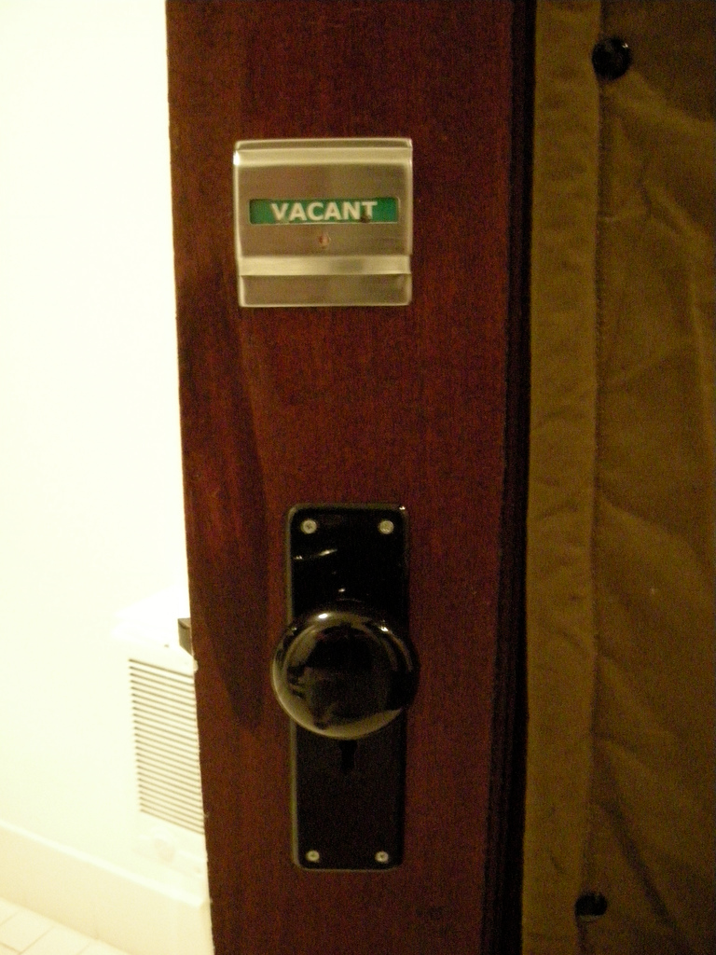
OS Synchronization Mechanisms
Synchronization mechanisms allow processes & threads to coordinate their execution order & the order in which they access shared resources
Mutexes – serialize execution of multiple threads by defining a “critical section” that can be executed by one thread at a time
Notes:
http://www.flickr.com/photos/81723626@N00/1340695074/

Slide 51
OS Synchronization Mechanisms
Synchronization mechanisms allow processes & threads to coordinate their execution order & the order in which they access shared resources
Mutexes – serialize execution of multiple threads by defining a “critical section” that can be executed by one thread at a time
There are two kinds of mutexes:
Nonrecursive mutex – will deadlock or fail if thread owning mutex tries to reacquire it without releasing it
Thread owning mutex must release it
Notes:
http://www.flickr.com/photos/81723626@N00/1340695074/

Slide 52
OS Synchronization Mechanisms
Synchronization mechanisms allow processes & threads to coordinate their execution order & the order in which they access shared resources
Mutexes – serialize execution of multiple threads by defining a “critical section” that can be executed by one thread at a time
There are two kinds of mutexes:
Nonrecursive mutex – will deadlock or fail if thread owning mutex tries to reacquire it without releasing it
Thread owning mutex must release it
Recursive mutex –will allow thread owning mutex to reacquire it without deadlocking
Owner thread must release it same # of times it acquired it
Notes:
http://www.flickr.com/photos/81723626@N00/1340695074/

Slide 53
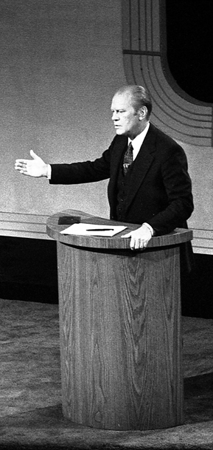

OS Synchronization Mechanisms
Synchronization mechanisms allow processes & threads to coordinate their execution order & the order in which they access shared resources
Readers/writer locks – allows access to a shared resource by either multiple threads simultaneously having read-only access or only one thread at a time having write access
Notes:
http://upload.wikimedia.org/wikipedia/commons/6/64/Carter_and_Ford_in_a_debate%2C_September_23%2C_1976.jpg

Slide 54
OS Synchronization Mechanisms
Synchronization mechanisms allow processes & threads to coordinate their execution order & the order in which they access shared resources
Readers/writer locks – allows access to a shared resource by either multiple threads simultaneously having read-only access or only one thread at a time having write access
They help improve app performance where resources are read much more often than written
Notes:
http://upload.wikimedia.org/wikipedia/commons/6/64/Carter_and_Ford_in_a_debate%2C_September_23%2C_1976.jpg

Slide 55

OS Synchronization Mechanisms
Synchronization mechanisms allow processes & threads to coordinate their execution order & the order in which they access shared resources
Semaphores – is a non-negative integer that can be incremented & decremented atomically
Notes:
http://www.flickr.com/photos/25048019@N03/2387819462/

Slide 56
OS Synchronization Mechanisms
Synchronization mechanisms allow processes & threads to coordinate their execution order & the order in which they access shared resources
Semaphores – is a non-negative integer that can be incremented & decremented atomically
A thread/process blocks when it tries to decrement a semaphore whose value is 0
Notes:
http://www.flickr.com/photos/25048019@N03/2387819462/

Slide 57
OS Synchronization Mechanisms
Synchronization mechanisms allow processes & threads to coordinate their execution order & the order in which they access shared resources
Semaphores – is a non-negative integer that can be incremented & decremented atomically
A thread/process blocks when it tries to decrement a semaphore whose value is 0
A blocked thread/process makes progress when another thread/ process increments the semaphore
Notes:
http://www.flickr.com/photos/25048019@N03/2387819462/

Slide 58
OS Synchronization Mechanisms
Synchronization mechanisms allow processes & threads to coordinate their execution order & the order in which they access shared resources
Semaphores – is a non-negative integer that can be incremented & decremented atomically
A thread/process blocks when it tries to decrement a semaphore whose value is 0
A blocked thread/process makes progress when another thread/ process increments the semaphore
Semaphores are often implemented via sleep locks, which trigger a context switch
Notes:
http://www.flickr.com/photos/25048019@N03/2387819462/

Slide 59
OS Synchronization Mechanisms
Synchronization mechanisms allow processes & threads to coordinate their execution order & the order in which they access shared resources
Condition variables – allows a thread to coordinate & schedule its own processing
A thread can wait on complex expressions to attain a desired state
Condition Variable
wait()
notify()
notifyAll()
Notes:
http://www.flickr.com/photos/25834786@N03/3316422085/, http://www.flickr.com/photos/60309882@N00/3041590472/, http://www.flickr.com/photos/29705797@N00/2892873127/

Slide 60
OS Synchronization Mechanisms
Synchronization mechanisms allow processes & threads to coordinate their execution order & the order in which they access shared resources
Condition variables – allows a thread to coordinate & schedule its own processing
A thread can wait on complex expressions to attain a desired state
Often used as building- blocks for patterns, such as Active Object & Monitor Object
RequestQueue
Client
2..*
synchronized get()
synchronized put()
uses
*
uses
Condition Variable
Mutex
wait()
notify()
notifyAll()
acquire()
release()
Notes:
http://www.flickr.com/photos/25834786@N03/3316422085/, http://www.flickr.com/photos/60309882@N00/3041590472/, http://www.flickr.com/photos/29705797@N00/2892873127/

Slide 61



OS Synchronization Mechanisms
Synchronization mechanisms allow processes & threads to coordinate their execution order & the order in which they access shared resources
Condition variables – allows a thread to coordinate & schedule its own processing
A thread can wait on complex expressions to attain a desired state
Often used as building- blocks for patterns, such as Active Object & Monitor Object
Notes:
http://www.flickr.com/photos/25834786@N03/3316422085/, http://www.flickr.com/photos/60309882@N00/3041590472/, http://www.flickr.com/photos/29705797@N00/2892873127/

Slide 62


Summary
Synchronization mechanism performance depends on OS implementation, hardware, & use cases
Notes:
http://www.flickr.com/photos/69621323@N00/4057676074/, http://www.flickr.com/photos/99472898@N00/4089072700/

Slide 63
Summary
Synchronization mechanism performance depends on OS implementation, hardware, & use cases
Notes:
http://www.flickr.com/photos/69621323@N00/4057676074/, http://www.flickr.com/photos/99472898@N00/4089072700/

Slide 64
Summary
Synchronization mechanism performance depends on OS implementation, hardware, & use cases
Notes:
http://www.flickr.com/photos/69621323@N00/4057676074/, http://www.flickr.com/photos/99472898@N00/4089072700/

Slide 65

Summary
Synchronization mechanism performance depends on OS implementation, hardware, & use cases
Some issues to keep in mind:
Condition variables & semaphores generally have higher overhead than mutexes
But they are also more expressive
Notes:
http://www.flickr.com/photos/27446438@N07/4846712316/

Slide 66
Summary
Synchronization mechanism performance depends on OS implementation, hardware, & use cases
Some issues to keep in mind:
Condition variables & semaphores generally have higher overhead than mutexes
Mutexes vs. Readers/Writer Locks – Mutexes generally have lower overhead than readers/writer locks
But readers/writer locks may enable more parallelism on multi-core processors
Notes:
http://www.flickr.com/photos/27446438@N07/4846712316/

Slide 67
Summary
Synchronization mechanism performance depends on OS implementation, hardware, & use cases
Some issues to keep in mind:
Condition variables & semaphores generally have higher overhead than mutexes
Mutexes vs. Readers/Writer Locks – Mutexes generally have lower overhead than readers/writer locks
Nonrecursive mutexes are more efficient than recursive mutexes
But they are also more error-prone
Notes:
http://www.flickr.com/photos/27446438@N07/4846712316/

Slide 68
Summary
Synchronization mechanism performance depends on OS implementation, hardware, & use cases
Some issues to keep in mind:
Condition variables & semaphores generally have higher overhead than mutexes
Mutexes vs. Readers/Writer Locks – Mutexes generally have lower overhead than readers/writer locks
Nonrecursive mutexes are more efficient than recursive mutexes
Not all operating systems support all these synchronization mechanisms, so it may be necessary to emulate some mechanisms in terms of others to ensure portability
int ACE_Recursive_Thread_Mutex ::acquire () {
ACE_thread_t t_id = ACE_OS::thr_self ();
ACE_Guard<ACE_Thread_Mutex> guard (lock);
if (nesting_level_ == 0) {
owner_id_ = t_id;
nesting_level_ = 1;
}
else if (t_id == owner_id_)
nesting_level_++;
else {
while (nesting_level_ > 0)
lock_available_.wait ();
owner_id_ = t_id;
nesting_level_ = 1;
}
return 0;
}
C++ “RAII” idiom
See en.wikipedia.org/wiki/Resource_Acquisition_Is_Initialization for RAII info
Notes:
http://www.flickr.com/photos/27446438@N07/4846712316/

Slide 69
Summary
Synchronization mechanism performance depends on OS implementation, hardware, & use cases
Some issues to keep in mind:
Condition variables & semaphores generally have higher overhead than mutexes
Mutexes vs. Readers/Writer Locks – Mutexes generally have lower overhead than readers/writer locks
Nonrecursive mutexes are more efficient than recursive mutexes
Not all operating systems support all these synchronization mechanisms, so it may be necessary to emulate some mechanisms in terms of others to ensure portability
int ACE_Recursive_Thread_Mutex ::acquire () {
ACE_thread_t t_id = ACE_OS::thr_self ();
ACE_Guard<ACE_Thread_Mutex> guard (lock);
if (nesting_level_ == 0) {
owner_id_ = t_id;
nesting_level_ = 1;
}
else if (t_id == owner_id_)
nesting_level_++;
else {
while (nesting_level_ > 0)
lock_available_.wait ();
owner_id_ = t_id;
nesting_level_ = 1;
}
return 0;
}
Notes:
http://www.flickr.com/photos/27446438@N07/4846712316/

Slide 70
Summary
Synchronization mechanism performance depends on OS implementation, hardware, & use cases
Some issues to keep in mind:
Condition variables & semaphores generally have higher overhead than mutexes
Mutexes vs. Readers/Writer Locks – Mutexes generally have lower overhead than readers/writer locks
Nonrecursive mutexes are more efficient than recursive mutexes
Not all operating systems support all these synchronization mechanisms, so it may be necessary to emulate some mechanisms in terms of others to ensure portability
int ACE_Recursive_Thread_Mutex ::acquire () {
ACE_thread_t t_id = ACE_OS::thr_self ();
ACE_Guard<ACE_Thread_Mutex> guard (lock);
if (nesting_level_ == 0) {
owner_id_ = t_id;
nesting_level_ = 1;
}
else if (t_id == owner_id_)
nesting_level_++;
else {
while (nesting_level_ > 0)
lock_available_.wait ();
owner_id_ = t_id;
nesting_level_ = 1;
}
return 0;
}
Notes:
http://www.flickr.com/photos/27446438@N07/4846712316/

Slide 71
Summary
Synchronization mechanism performance depends on OS implementation, hardware, & use cases
Some issues to keep in mind:
Condition variables & semaphores generally have higher overhead than mutexes
Mutexes vs. Readers/Writer Locks – Mutexes generally have lower overhead than readers/writer locks
Nonrecursive mutexes are more efficient than recursive mutexes
Not all operating systems support all these synchronization mechanisms, so it may be necessary to emulate some mechanisms in terms of others to ensure portability
int ACE_Recursive_Thread_Mutex ::acquire () {
ACE_thread_t t_id = ACE_OS::thr_self ();
ACE_Guard<ACE_Thread_Mutex> guard (lock);
if (nesting_level_ == 0) {
owner_id_ = t_id;
nesting_level_ = 1;
}
else if (t_id == owner_id_)
nesting_level_++;
else {
while (nesting_level_ > 0)
lock_available_.wait ();
owner_id_ = t_id;
nesting_level_ = 1;
}
return 0;
}
Notes:
http://www.flickr.com/photos/27446438@N07/4846712316/

Slide 72
Summary
Synchronization mechanism performance depends on OS implementation, hardware, & use cases
Some issues to keep in mind:
Condition variables & semaphores generally have higher overhead than mutexes
Mutexes vs. Readers/Writer Locks – Mutexes generally have lower overhead than readers/writer locks
Nonrecursive mutexes are more efficient than recursive mutexes
Not all operating systems support all these synchronization mechanisms, so it may be necessary to emulate some mechanisms in terms of others to ensure portability
int ACE_Recursive_Thread_Mutex ::acquire () {
ACE_thread_t t_id = ACE_OS::thr_self ();
ACE_Guard<ACE_Thread_Mutex> guard (lock);
if (nesting_level_ == 0) {
owner_id_ = t_id;
nesting_level_ = 1;
}
else if (t_id == owner_id_)
nesting_level_++;
else {
while (nesting_level_ > 0)
lock_available_.wait ();
owner_id_ = t_id;
nesting_level_ = 1;
}
return 0;
}
Notes:
http://www.flickr.com/photos/27446438@N07/4846712316/

Slide 73
Summary
Synchronization mechanism performance depends on OS implementation, hardware, & use cases
Some issues to keep in mind:
Condition variables & semaphores generally have higher overhead than mutexes
Mutexes vs. Readers/Writer Locks – Mutexes generally have lower overhead than readers/writer locks
Nonrecursive mutexes are more efficient than recursive mutexes
Not all operating systems support all these synchronization mechanisms, so it may be necessary to emulate some mechanisms in terms of others to ensure portability
int ACE_Recursive_Thread_Mutex ::acquire () {
ACE_thread_t t_id = ACE_OS::thr_self ();
ACE_Guard<ACE_Thread_Mutex> guard (lock);
if (nesting_level_ == 0) {
owner_id_ = t_id;
nesting_level_ = 1;
}
else if (t_id == owner_id_)
nesting_level_++;
else {
while (nesting_level_ > 0)
lock_available_.wait ();
owner_id_ = t_id;
nesting_level_ = 1;
}
return 0;
}
Note use of condition variable
Notes:
http://www.flickr.com/photos/27446438@N07/4846712316/

